Slide 1
SIEM-ulation
Diving into Incident Response with Splunk
Carlos Marquez
Karanbir Ahuja

Slide 2
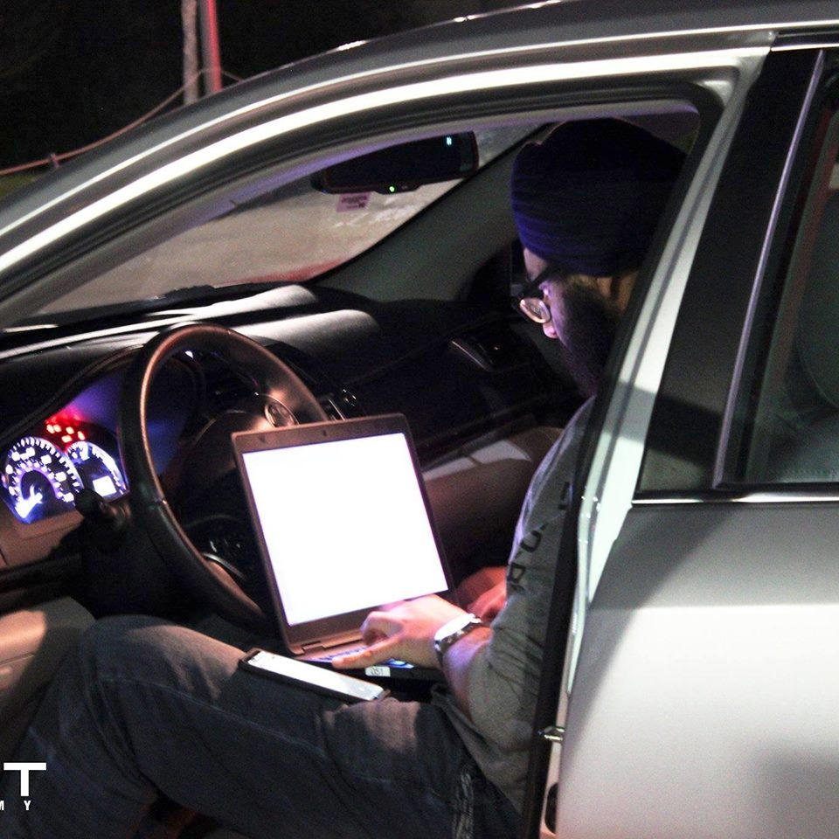
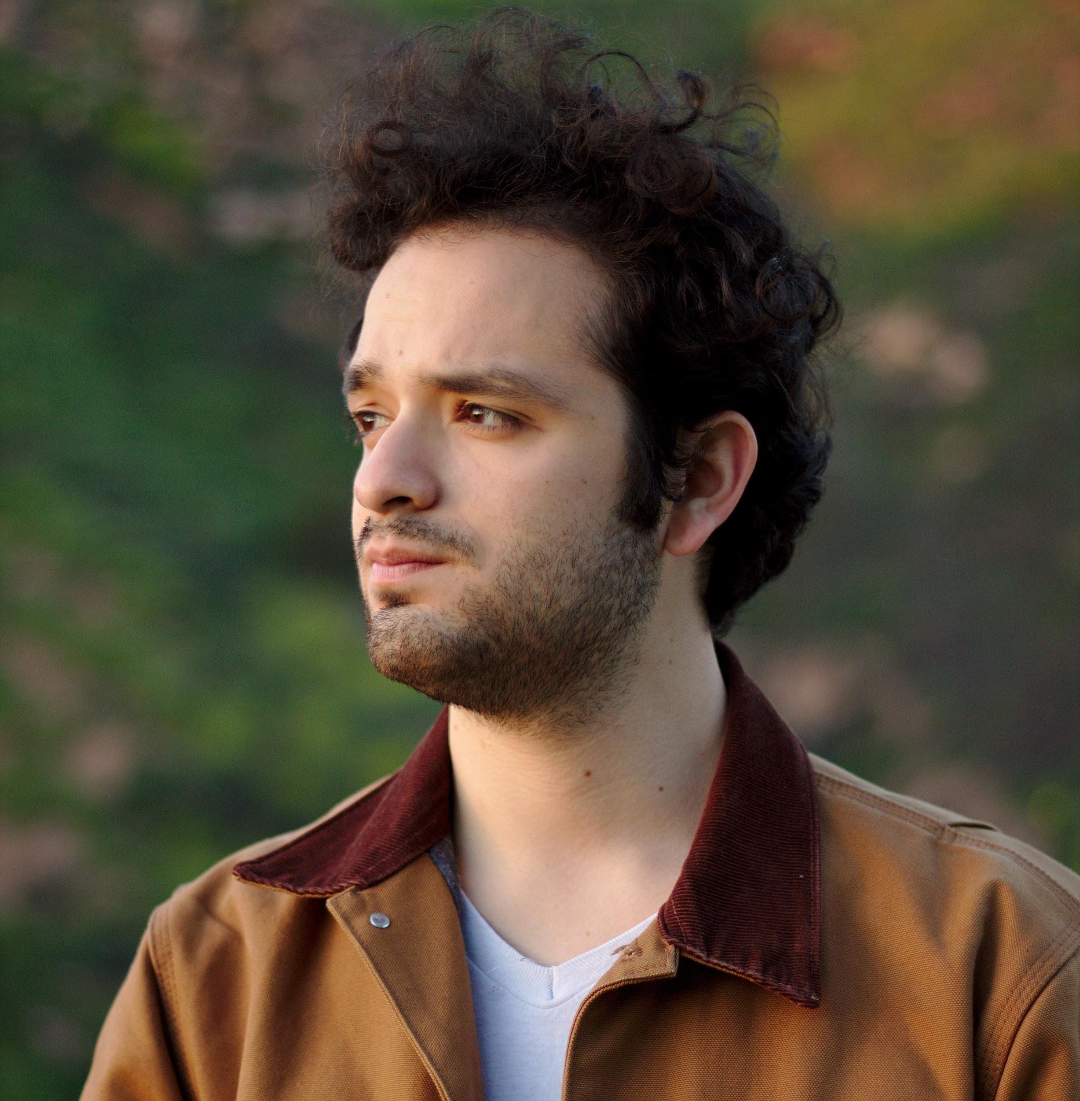
About Us
Karanbir Ahuja
3rd year CIS, Cal Poly Pomona
D-CISO, Mitchell C Hill SDC
Director of SWIFT Academy
Kaiser Forensics/EDiscovery Intern
Carlos Marquez
3rd-year CS, Cal Poly Pomona
CISO, Mitchell C Hill SDC
Lead, CPP Student SOC
PolySec Lab

Slide 3
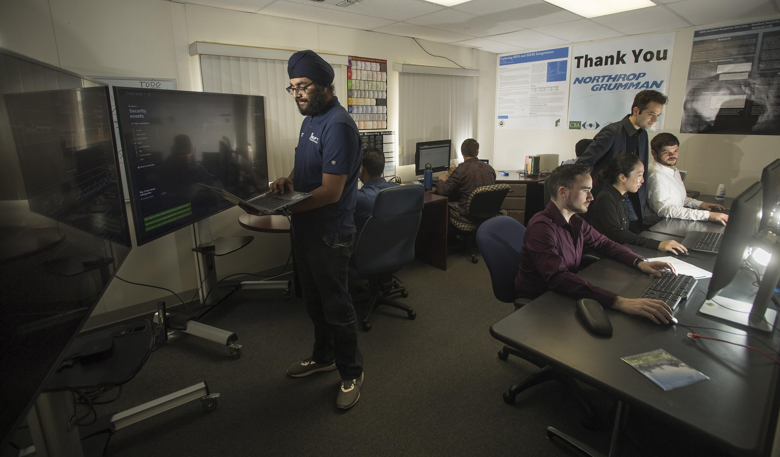
The CSIRP and the Student SOC
What is a SOC?
SOC Services
The CSIRP
Key Functions of the Student SOC
Student SOC Activities/Partnerships
Notes:
SOC: "A centralized team in a single organization that monitors the information technology environment for vulnerabilities, unauthorized activity, acceptable use/policy/procedure violations, intrusions into and out of the network, and provides direct support for the CSIR process"
Services: Vulnerability Management, Auditing, Forensics/eDiscovery (Karanbir Brief explanation)
Focus on key service: Monitoring security posture.
Cyber Security Instructional Research Project: Led by Dr. Pike and Dr. Husain.
Our functions: Provide hands-on training with industry tools, support security research on campus, provide security monitoring services to the Student-run Data Center.
Partnerships: LA Cyber Lab tour. IBM working on research, helped them with testing training environment.

Slide 4
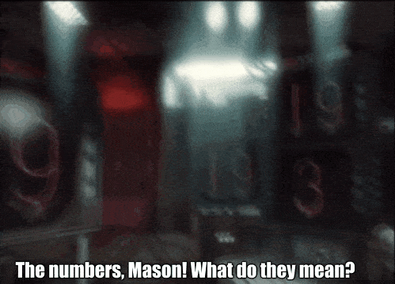
SOC and SIEM
Security Information & Event Management
SOC Evolution required analysis of large datasets
QRadar, Splunk, LogRhythm
Aggregation, normalization, and correlation of highly variable data.
Very powerful.
Notes:
SOC evolved from sysadmins doing security - looking at decentralized event logs, basic IDS, firewall. Investigation very difficult.

Slide 5
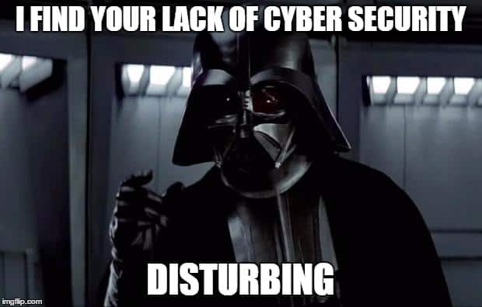
SOC and SIEM (cont.)
Where good security comes from:
SOC with clear authority, reporting, accountability, etc.
Awareness of business and IT environment
Understanding your scope and how you support the business
Investing in people, not software
Analysts that are calm, interpret alarms correctly, know supporting data
Where good security does not come from:
Buying an expensive tool to tick an audit checkbox, then leaving that tool alone forever

Slide 6
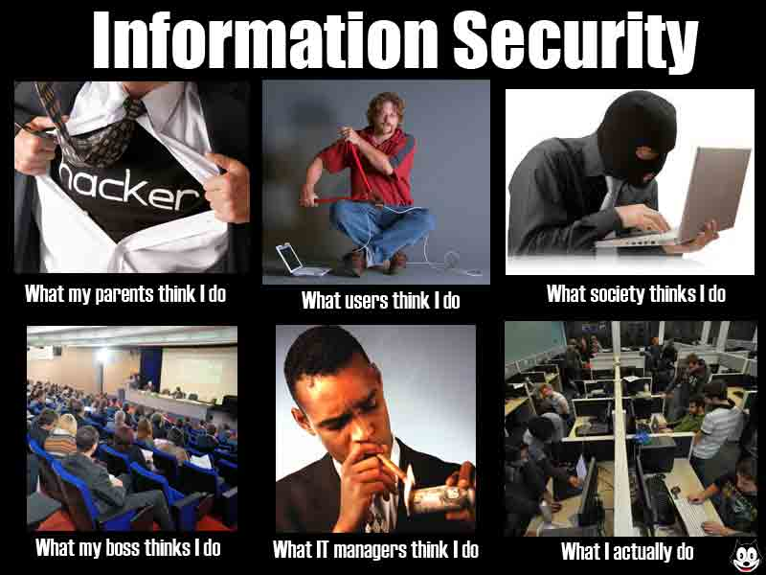
SOC Analysts
Tier 1
Monitor, follow SOP
Run reports
SIEM health
Escalate complex cases
Tier 2
Analyzing T1-passed cases
Research new alarms/events
Longitudinal analysis
Daily/weekly threat hunting (more on this later)
Notes:
Complex cases only escalated by T1 after initial investigation.
‘The drinking isn’t on there, Carlos’
‘The drinking isn’t a meme’

Slide 7
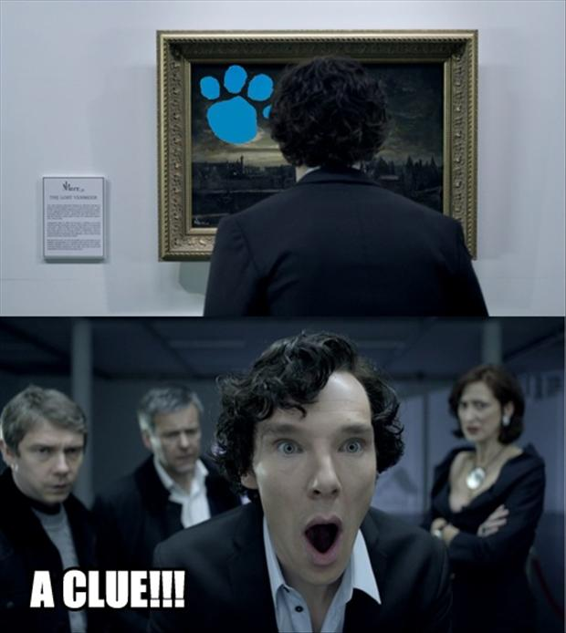
SOC Analysts (cont.)
Why be an analyst?
How analysts are changing
Analyst traits
Notes:
Why: Solve puzzles for a living. Always something new to investigate. Bureau of Labor Statistics 2017: Information Security Analyst base pay $95.
How: Used to be sysadmins, remember? Going straight into security means you need to build background to understand what you’re seeing.
Traits: Curiosity, finding needle in haystack, abstract thinking, contextualize large datasets, communicate information/what it means, small ego but pride in work

Slide 8

SOC Analyst: A Day in the Life
Review alarms
Dashboards
Security monitoring status
SIEM Health Checks
Report IT Issues
Active Threat Hunting
Security Intelligence
Notes:
Triage: High to low severity. These must be tuned or you’re not doing anything useful. Take care of your SIEM - don’t run too many searches at once. When done, action should match alert - some alerts are non-actionable and that’s fine.
Dashboard: Long-tail analysis: Look at highs and lows. Utilize threat intelligence for easy points. Check SIEM data sources for new or lost event types
Security monitoring status: Validate data sources reporting, alert if they are not.
SIEM Health: System health. Large shifts in event volume. Test low volume sources to ensure they’re reporting. Ensure current threat feed data.
IT Issues: You find weird broken things looking at logs. Tell IT about it, it might fix something they’re scratching their heads on.
Active threat hunting can spice up your SOC experience.
Security Intelligence: Newsletters, OTX Pulses, Twitter, or whatever.

Slide 9
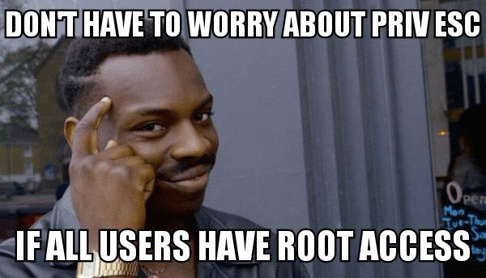
Investigation - Cyber Kill Chain
Lockheed Martin Cyber Kill Chain
Recon
Weaponization
Delivery
Exploitation
Installation
Command/Control
Act on Objectives
Notes:
Harvesting emails
Exploit + backdoor
Deliver through email, web, USB
Exploit vuln to execute code on system
Install malware
Control victim remotely
Accomplish original goals - ransomware, data destruction, exfil, etc.

Slide 10
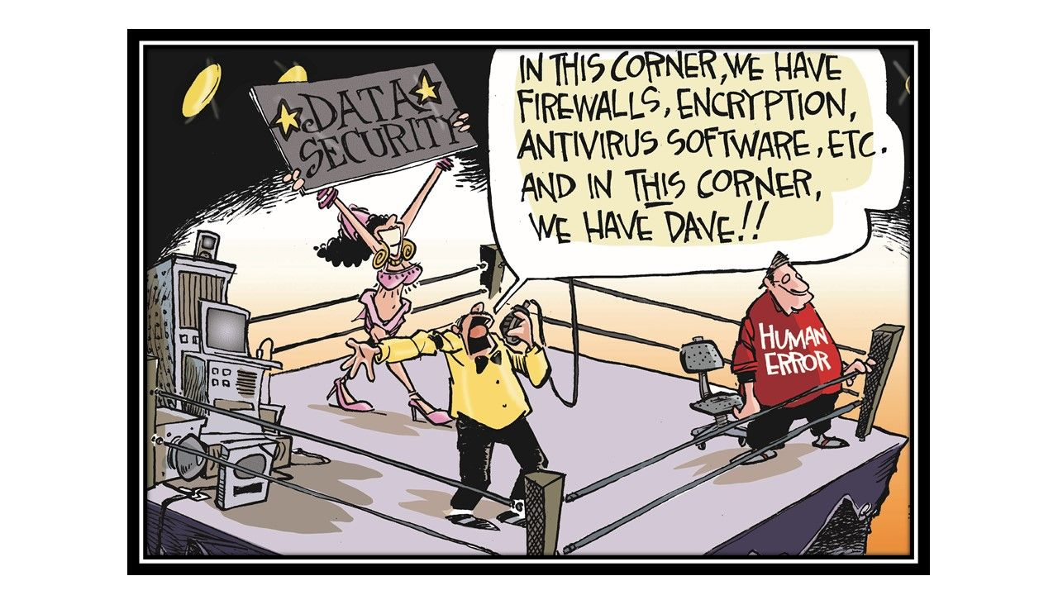
Investigation - OODA Loop
Col. John Boyd, USAF
Observe
Orient
Decide
Act
Notes:
Observe: What data do you have?
Orient: What does it mean?
Decide: What should you do about it?
Act.
This might seem simple. It’s because it sort of is. When you’re uncertain of something (especially in a crisis), the OODA loop will help you to find your place and succeed.

Slide 11
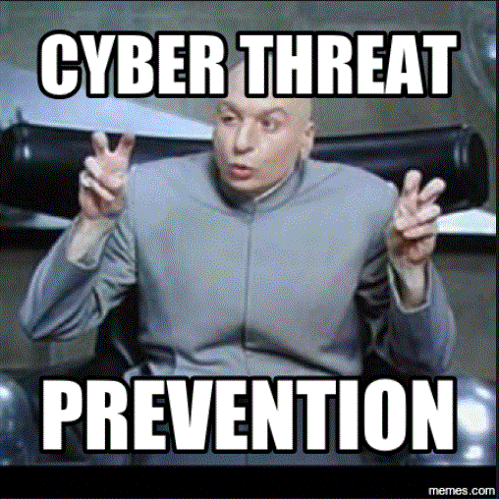
Investigation - Guidelines
System compromises/high severity take priority
Build a timeline, list of indicators
Pick your data sources wisely
Graphs
Notes:
Data sources: Choose the sources that can give you data on the data point you’re investigating.
Graphs - where could the attacker move from here? What’s a viable attack path?
1 alarm/analyst/hr, about 5 per day

Slide 12

Investigation - Well-rounded Analysis
True Positive (TP) or False Positive (FP)?
Don’t waste time on dead ends
Pull out details, pivot
Know what your alarms mean.
Proving the negative is more efficient.
Don’t start with raw data.
Notes:
Pull alarms apart. Look at the logic conditions. Look at their dependencies. Trace out how the events met the conditions.
Proving negative: Proving TP is biased. It takes ⅔ more time than FP - Chris Sanders, Applied Network Defense.
Raw data: Some people like to drop straight into PCAP. Your SIEM pulls fields for you for a reason. Starting with raw PCAP data increases time to investigate - Chris Sanders.

Slide 13

Investigation - Cognitive Bias
What is cognitive bias?
Compensating
Looking for IOC’s that aren’t there
Notes:
Cognitive Bias: Systemic pattern of deviation from norm or rationality in judgment
In security: Error in processing information leading to an incorrect conclusion, distortion of information, or illogical determination.
Your thoughts/feelings/beliefs WILL affect your investigation. Compensate by getting more data, considering the alternative, possibly testing in a sandbox.

Slide 14
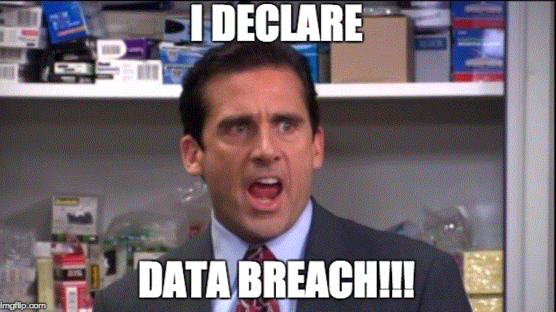
Threat Hunting
What is threat hunting?
What can you find that your SIEM doesn’t?
Establish a baseline, find deviations
Generate a hypothesis and test it.
Notes:
Def: Leveraging information to proactively search out and identify if an attacker was successful in compromising your network, applications, data sources, or systems on an iterative basis.
Generating Hypotheses: SANS Paper
- Your ability to generate H is based on observations
- H must be testable, grounded in reality, resusable. Guard against bias.
- Hunter must know their tools and data
- Use IOCs and TTPs in your investigation
- Put IOCs in context and understand their shelf life
- Identify your most important data sources and applications, build attack graphs and pathways to inform monitoring/hunts
- People, processes, and business are critical to the threat landscape

Slide 15
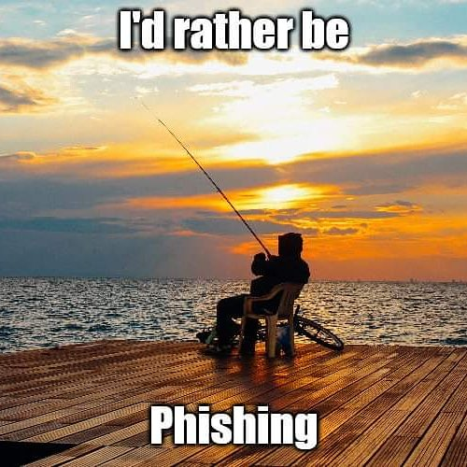
Threat Hunting - MITRE ATT&CK
Adversarial Tactics, Techniques, & Common Knowledge
Methods for entering network, establishing persistence, etc.
How would you log and detect each part of the attack?
attack.mitre.org

Slide 16
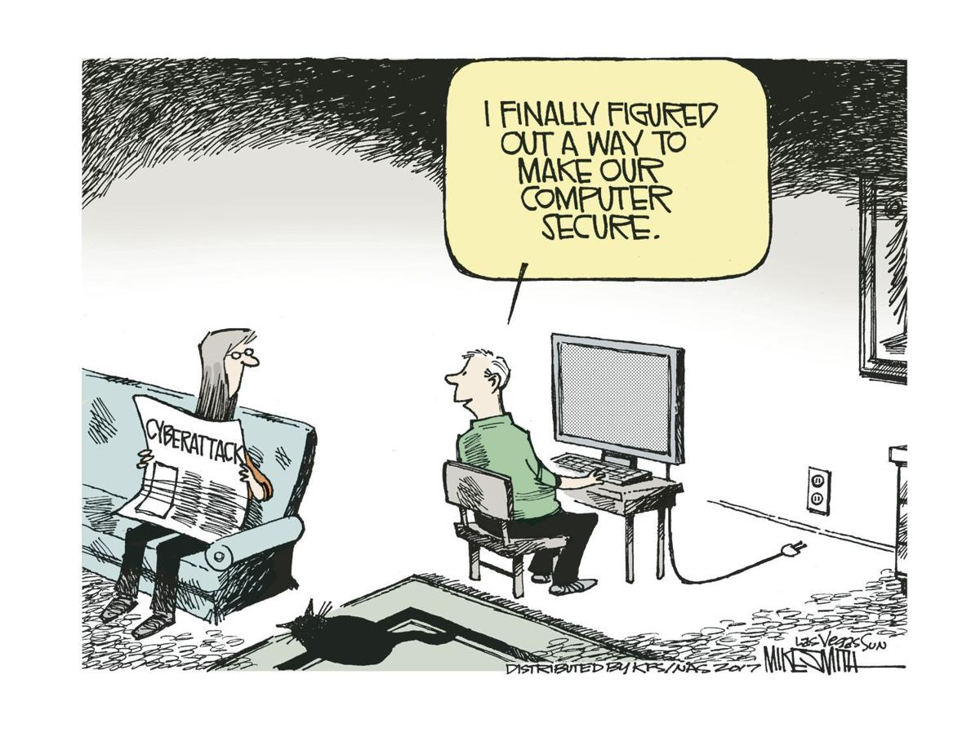
Threat Hunting - What to Look For
Command-and-Control (C2)
BHIS RITA - AI Threat Hunting
Top Ten IP addresses
Privileged Account Usage
Life Cycle Events for Elevated Groups

Slide 17
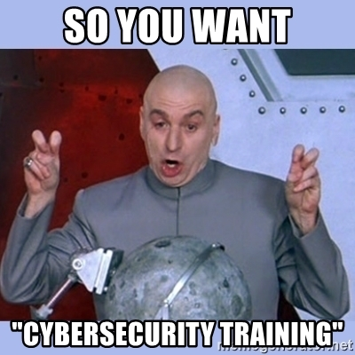
Resources - Where to Learn More
Don Murdoch Blue Team Handbook Series
Black Hills Information Security
Security Weekly
CPP Student SOC!

Slide 18
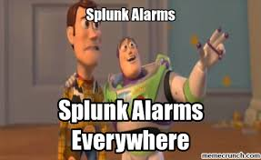
Demo -
Incident Response with Splunk

Slide 19
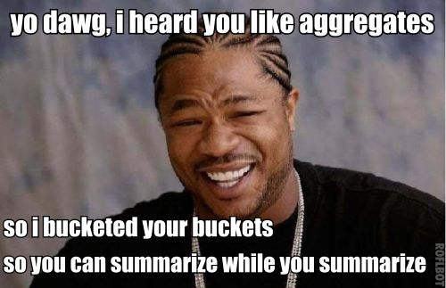
Splunk’s components
Search Head
Indexer
Forwarder
Notes:
Talk about Buckets in Indexer

Slide 20
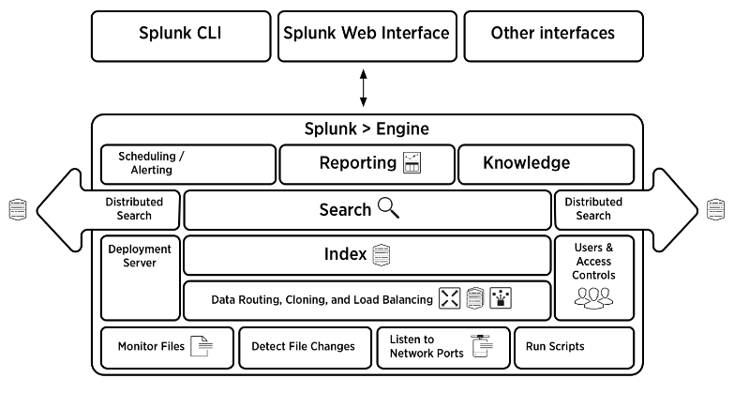
Notes:
Talk about Clustering servers

Slide 21
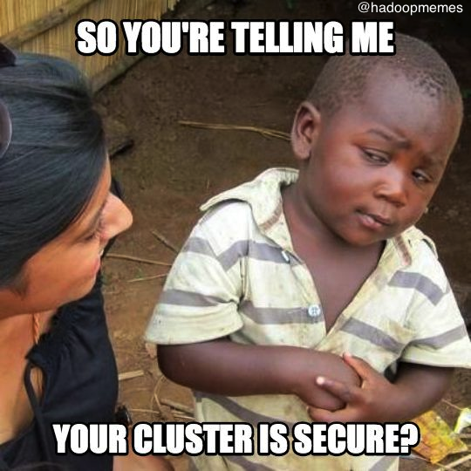
Infrastructure needed
Next to nothing
Docker
Virtual Machine
Bare Metal
Notes:
Splunk runs on anything so long as the data inflow and searching doesn’t overload it

Slide 22
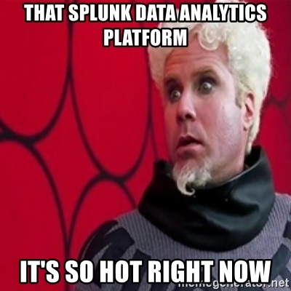
Splunk Datasets
Sysmon
Syslog
Active Directory
Wordpress/Apache
MySQL
Hadoop
Palo Alto
Fortinet
Fireye
Notes:
Ask people to name sources

Slide 23
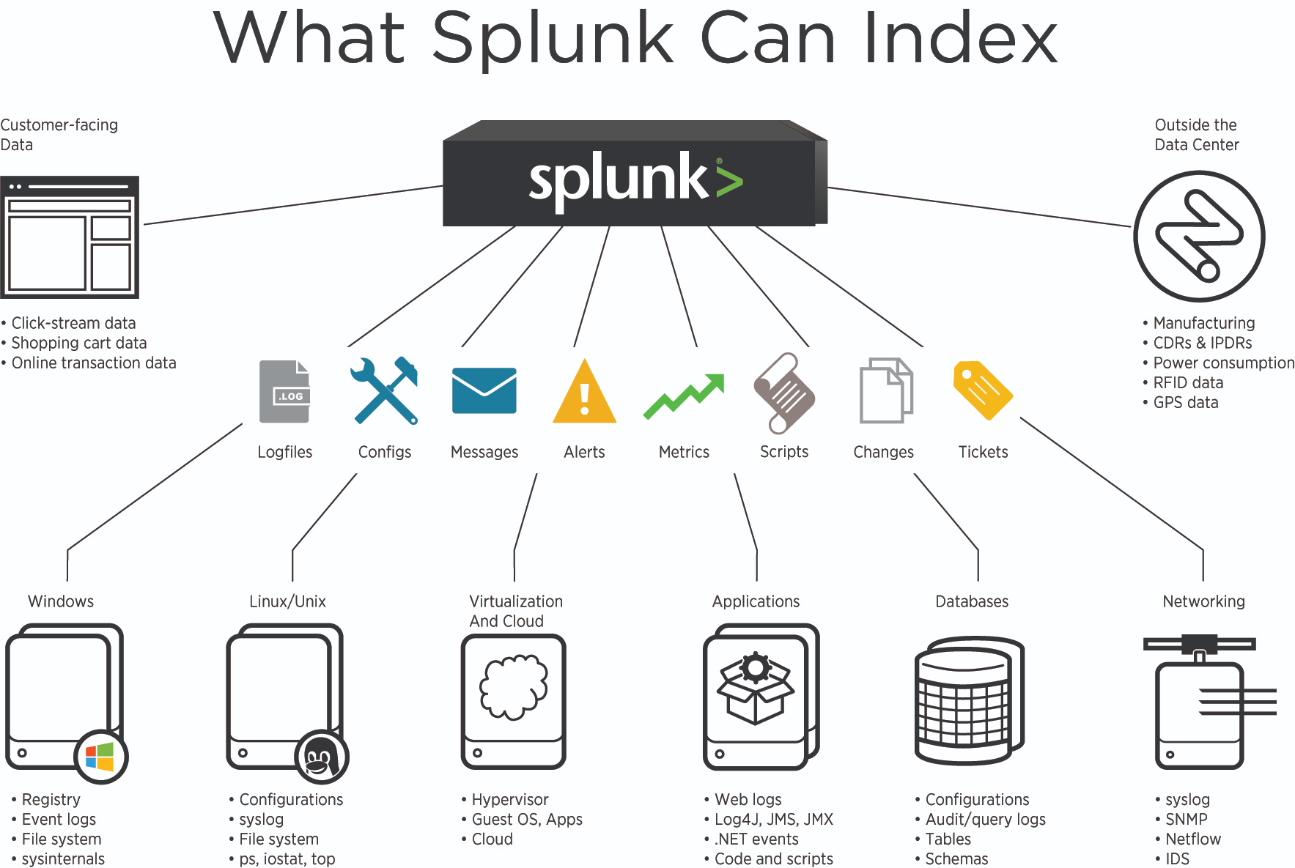

Slide 24
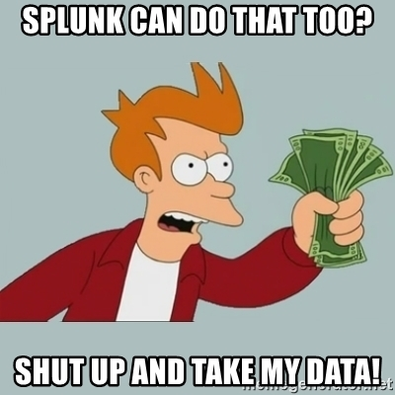
Some Use Cases for Splunk
Data Analytics
Big Data
Security
Network Monitoring
Log Infrastructure
DevOps
Chef and Jenkins
Cloud monitoring
AWS
Azure
Notes:
Ask people for more use cases
Can also log survey data for employee satisfaction

Slide 25
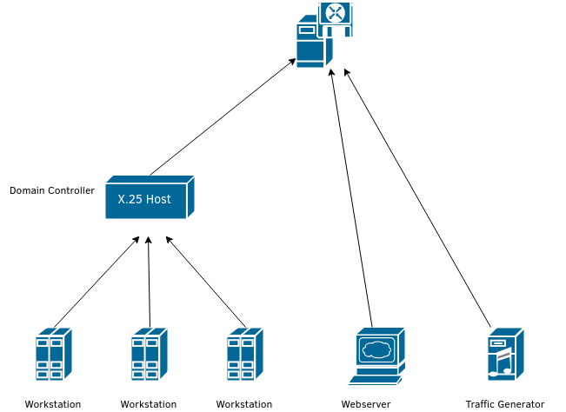

Slide 26
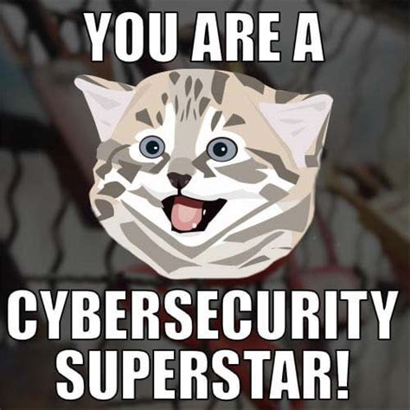
Conclusion
Thanks for attending!
Carlos Marquez
cmarquez2@cpp.edu
flicker#7231
Karanbir Ahuja
ksahuja@cpp.edu
Turb0Yoda#0001

